Slide 1
I/O Interface

Slide 2
Input/ Output Devices
Input / Output devices are the means through which the microcomputer unit communicates with the outside world.
The link between the I/O devices and the microprocessor is maintained by a circuitry known as I/O module.
For interfacing of typical microprocessor to I/O devices such as keyboard, CRT, printer etc., all need I/O interface circuits which are of mainly two types.

Slide 3
1. Serial Interface / Serial Communication
Data are transferred serially one bit at a time starting from Least Significant bit.
Slow due to single communication link but inexpensive to implement.
It uses clock to separate consecutive bits.
Its function is to deal with the data on the bus in the parallel mode and communicate with the connected device in serial mode.
Its data bus has n data lines, the serial I/O interface accepts n bit of data simultaneously from the bus and n bits are sent one at a time thus requiring n time slots.
Not suitable for fast operation needed microprocessor.

Slide 4
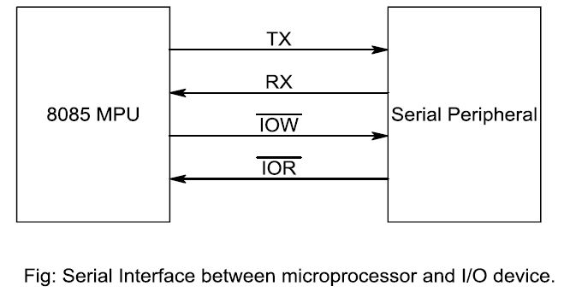

Slide 5
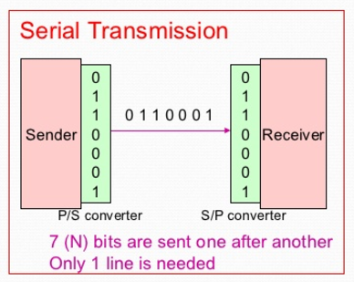

Slide 6
1) Synchronous serial data transmission:
Data is transmitted or received based on a clock signal i.e. synchronously.
The transmitting device sends a data bit at each clock pulse.
Usually one or more SYNC characters are used to indicate the start of each synchronous data stream.
SYNC characters for each frame of data.
Transmitting device sends data continuously to the receiving device. If the data is not ready to be transmitted, the transmitter will send SYNC character until the data is available.
The receiving device waits for data, when it finds the SYNC characters then starts interpreting the data.

Slide 7
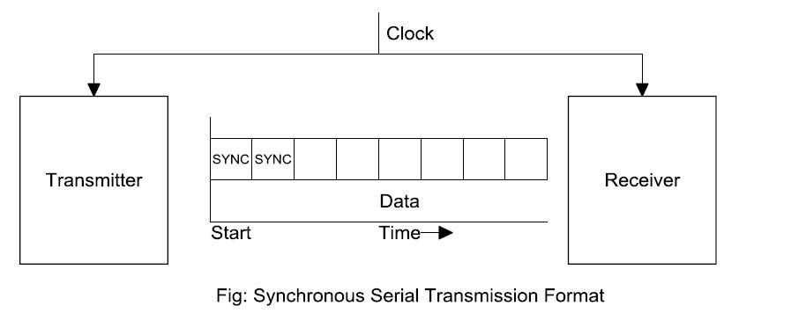

Slide 8
2) Asynchronous serial data transmission:
The receiving device does not need to be synchronized with the transmitting device.
Transmitting device send data units when it is ready to send data.
Each data unit must contain start and stop bits for indicating beginning and the end of data unit. And also one parity bit to identify odd or even parity data.
For e.g. To send ASCII character (7 bit)
We need:
1 start bit: beginning of data
1 stop bit: End of data
1 Parity bit: even or odd parity
7 bit character: actual data transferred

Slide 9
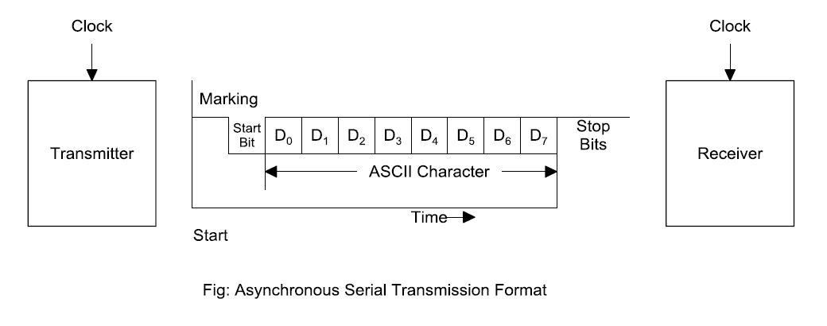

Slide 10
Synchronous vs. Asynchronous Data Communication
Asynchronous Communication
Simple interface (limited data rate, typically < 64 kbps)
Used for connecting: Printer, Terminal, Modem, home connections to the Internet
No clock sent (Tx & Rx have own clocks)
Requires start and stop bits which provides byte timing and increases overhead
Parity often used to validate correct reception.
Independent transmit & receive clocks
Synchronous Communication
Clock sent with data (more configuration options).
Synchronized transmit & receive clocks.
More complex interface (high data rates supported up to ~ 10 Gbps)
Used for: Connections between computer and telephony networks.

Slide 11
Universal Synchronous Asynchronous Receiver Transmitter (USART) – 8251A
The 8251A is a programmable serial communication interface chip designed for synchronous and asynchronous serial data communication.
It supports the serial transmission of data.

Slide 12
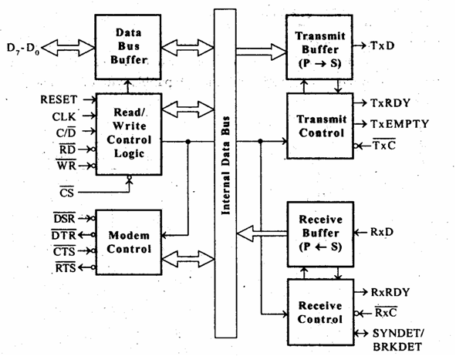
Fig: Functional Block Diagram of (USART) – 8251A

Slide 13
2. Parallel Interface / Parallel Communication
The device which can handle data at higher speed cannot support with serial interface.
N bits of data are handled simultaneously by the bus and the links to the device directly.
Achieves faster communication but becomes expensive due to need of multiple wires.
The techniques used to transfer data between different speed devices and computer is called synchronizing.

Slide 14
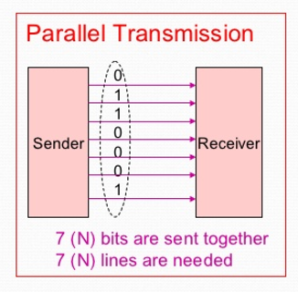

Slide 15
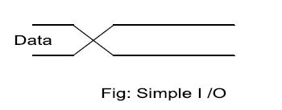
METHODS OF PARALLEL DATA TRANSFER
Different techniques under synchronizing are:
1) Simple I/O
For simple I/O, LED are always connected to the input and output ports.
The devices are always ready to send or receive data.
Here cross line indicate the time for new valid data.
When you need to get digital data from a simple switch, all you have to do is connect the switch to an I/P port line and read the value.
Likewise, when you need to O/P data to simple LED, all you have to do is connect the LED to an O/P port and send the value.
The LED is always ready, so you can send data at any time.

Slide 16
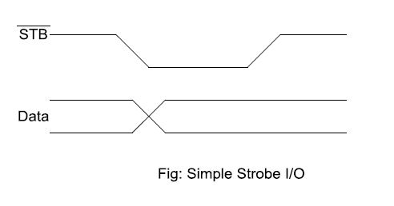
2) Wait Interface( Simple strobe I/O)
In this technique, MP need to wait until the device is ready for the operation.

Slide 17
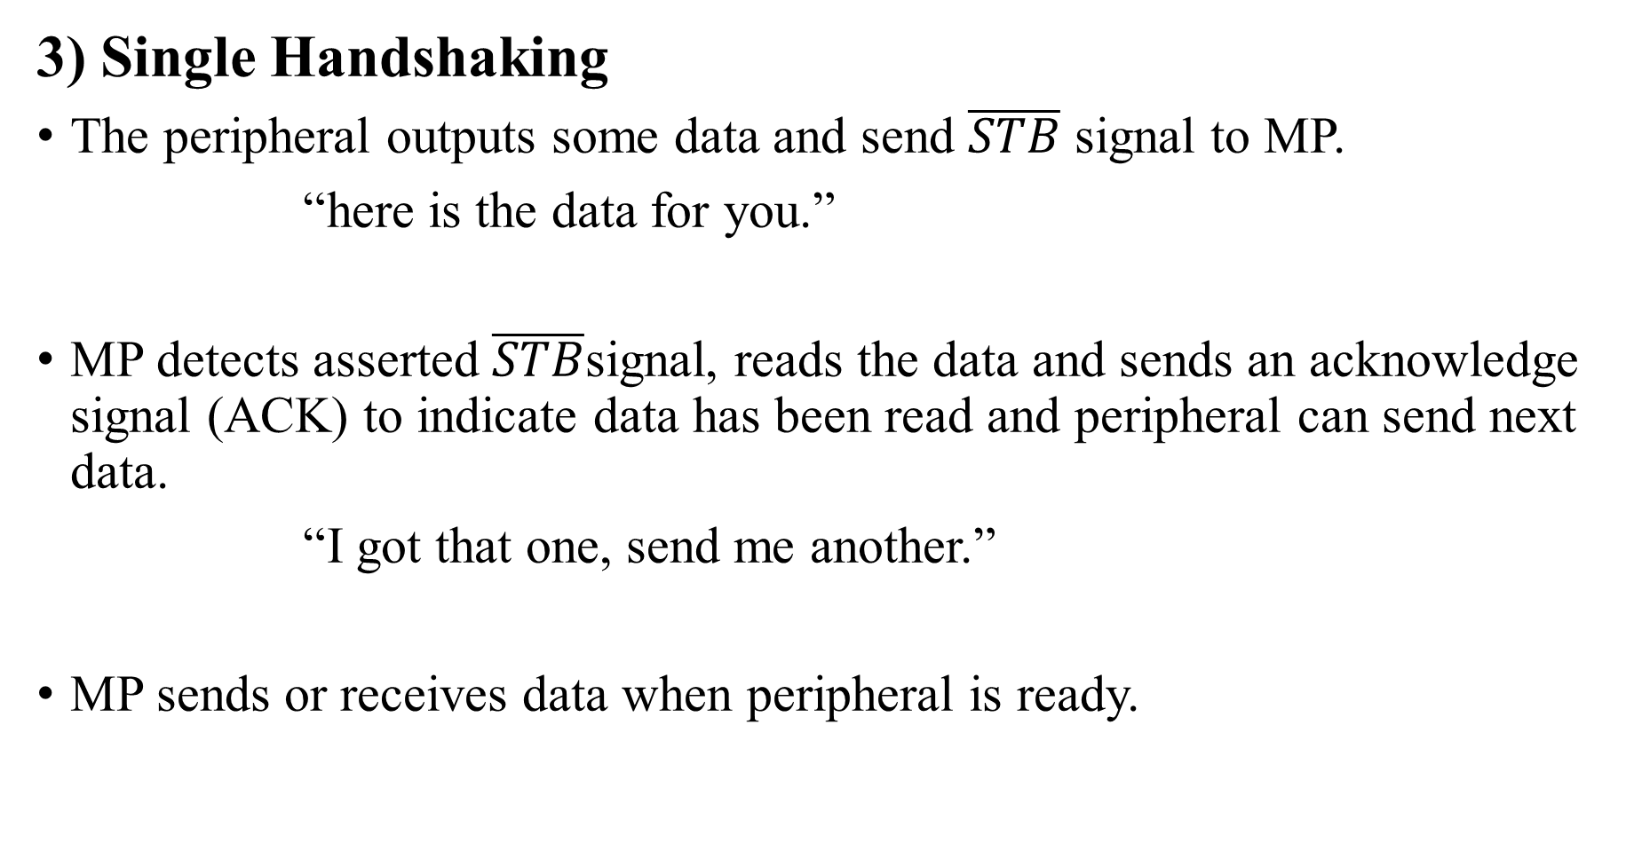
3) Single Handshaking
The peripheral outputs some data and send $\overline{STB}$ signal to MP.
“here is the data for you.”
MP detects asserted $\overline{STB}$signal, reads the data and sends an acknowledge signal (ACK) to indicate data has been read and peripheral can send next data.
“I got that one, send me another.”
MP sends or receives data when peripheral is ready.

Slide 18
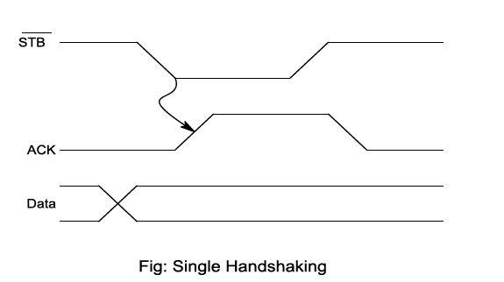

Slide 19
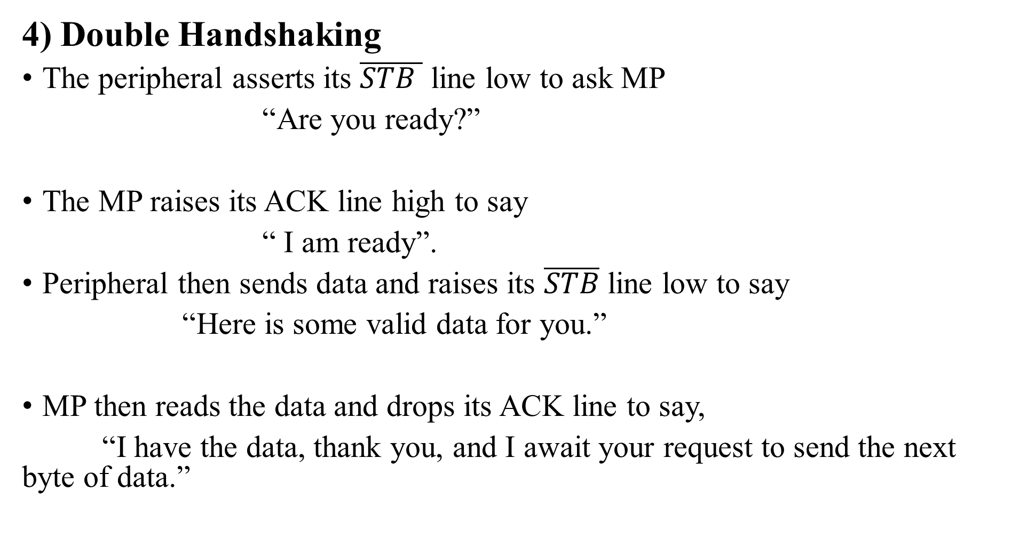
4) Double Handshaking
The peripheral asserts its $\overline{STB }$ line low to ask MP
“Are you ready?”
The MP raises its ACK line high to say
“ I am ready”.
Peripheral then sends data and raises its $\overline{STB}$ line low to say
“Here is some valid data for you.”
MP then reads the data and drops its ACK line to say,
“I have the data, thank you, and I await your request to send the next byte of data.”

Slide 20
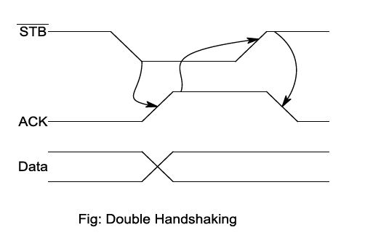

Slide 21
Programmable Peripheral Interface (PPI) - 8255A
The INTEL 8255 is a device used to parallel data transfer between processor and slow peripheral devices like ADC, DAC, keyboard, 7-segment display, LCD, etc.
The 8255 has three ports: Port-A, Port-B and Port-C.
Port-A can be programmed to work in any one of the three operating modes mode-0, mode-1 and mode-2 as input or output port.
Port-B can be programmed to work either in mode-0 or mode-1 as input or output port.
Port-C (8-pins) has different assignments depending on the mode of port-A and port-B.

Slide 22
If port-A and B are programmed in mode-0, then the port-C can perform any one of the following functions.
As 8-bit parallel port in mode-0 for input or output.
As two numbers of 4-bit parallel ports in mode-0 for input or output.
The individual pins of port-C can be set or reset for various control applications.
If port-A is programmed in mode- 1/mode-2 and port-B is programmed in mode-1 then some of the pins of port-C are used for handshake signals and the remaining pins can be used as input/ output lines or individually set/reset for control application.

Slide 23
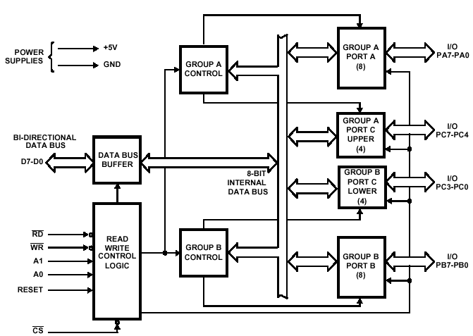
Fig: Programmable Peripheral Interface (PPI) – 8255 A architecture

Slide 24
Key Features of Mode-0,Mode-1 and Mode-2
Mode 0: Ports A and B operate as either inputs or outputs and Port C is divided into two 4-bit groups either of which can be operated as inputs or outputs
Mode 1: Same as Mode 0 but Port C is used for handshaking and control
Mode 2: Port A is bidirectional (both input and output) and Port C is used for handshaking. Port B is not used.

Slide 25
The read/write control logic requires six control signals. These signals are given below.
1. RD (low): This control signal enables the read operation. When this signal is low, the microprocessor reads data from a selected I/O port of the 8255A.
2. WR (low): This control signal enables the write operation. When this signal goes low, the microprocessor writes into a selected I/O port or the control register.
3. RESET: This is an active high signal. It clears the control register and set all ports in the input mode.
4. CS (low), A0 and A1: These are device select signals. They are

Slide 26
Internal devices | A1 | A0
Port A | 0 | 0
Port B | 0 | 1
Port C | 1 | 0
Control Register | 1 | 1

Slide 27
RS -232
RS-232 is a standard for serial communication transmission of data
RS-232 is a standard communication protocol for linking computer and its peripheral devices to allow serial data exchange.
RS-232C is an interface developed to standardize the interface between data terminal equipment (DTE) and data communication equipment (DCE) employing serial binary data exchange. Modem and other devices used to send serial data are called data communication equipment (DCE). The computers or terminals that are sending or receiving the data are called data terminal equipment (DTE).
Equipment (DTE) RS- 232C is the interface standard developed by electronic industries Association (EIA) in response to the need for the signal and handshake standards between the DTE and DCE.
It uses 25 pins (DB – 25P) or 9 Pins (DE – 9P) standard where 9 pin standard does not use all signals i. e. data, control, timing and ground.
It describes the voltage levels, impendence levels, rise and fall times, maximum bit rate and maximum capacitance for all signal lines.

Slide 28
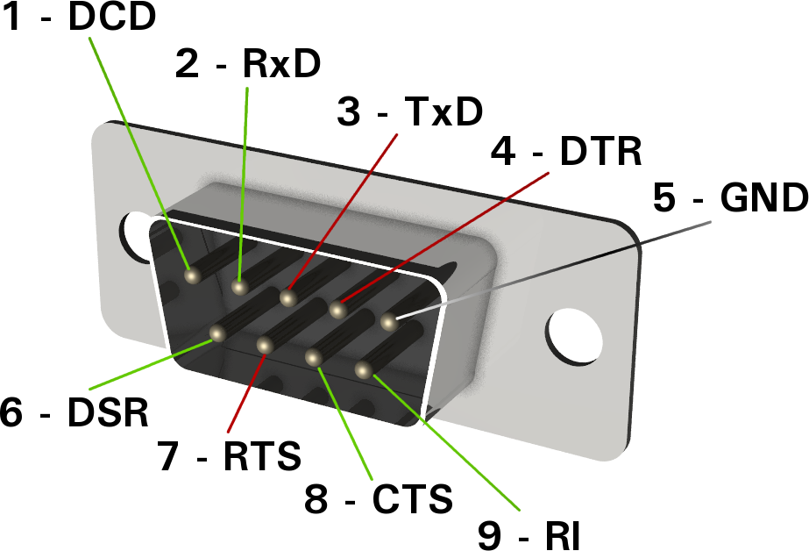
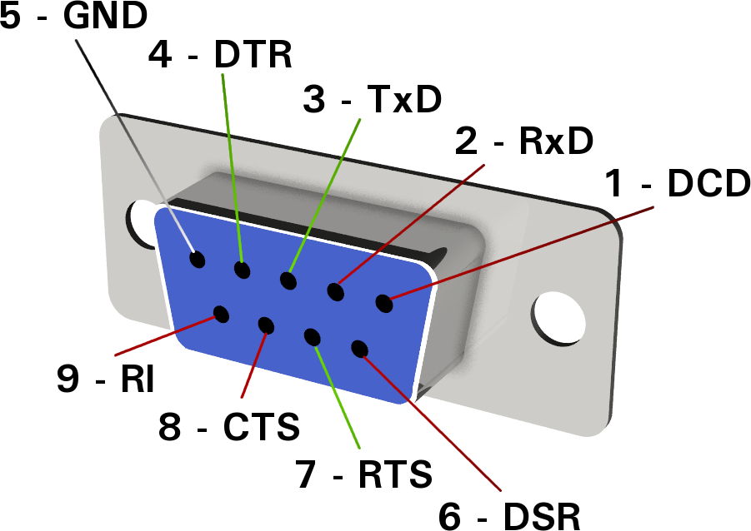
Fig: RS-232 DB-9 male connector at the data terminal equipment (DTE).
Fig: RS-232 DB-9 female connector at the data communication equipment (DCE).

Slide 29
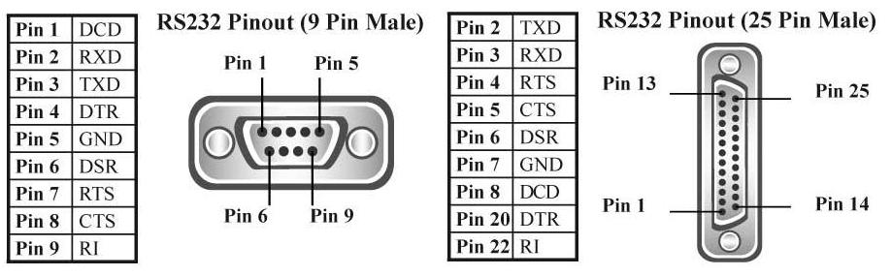

Slide 30
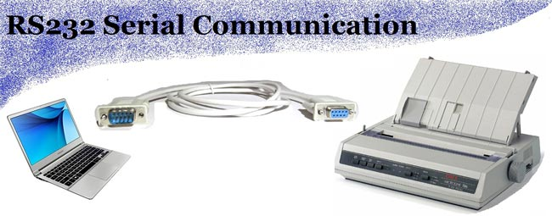

Slide 31
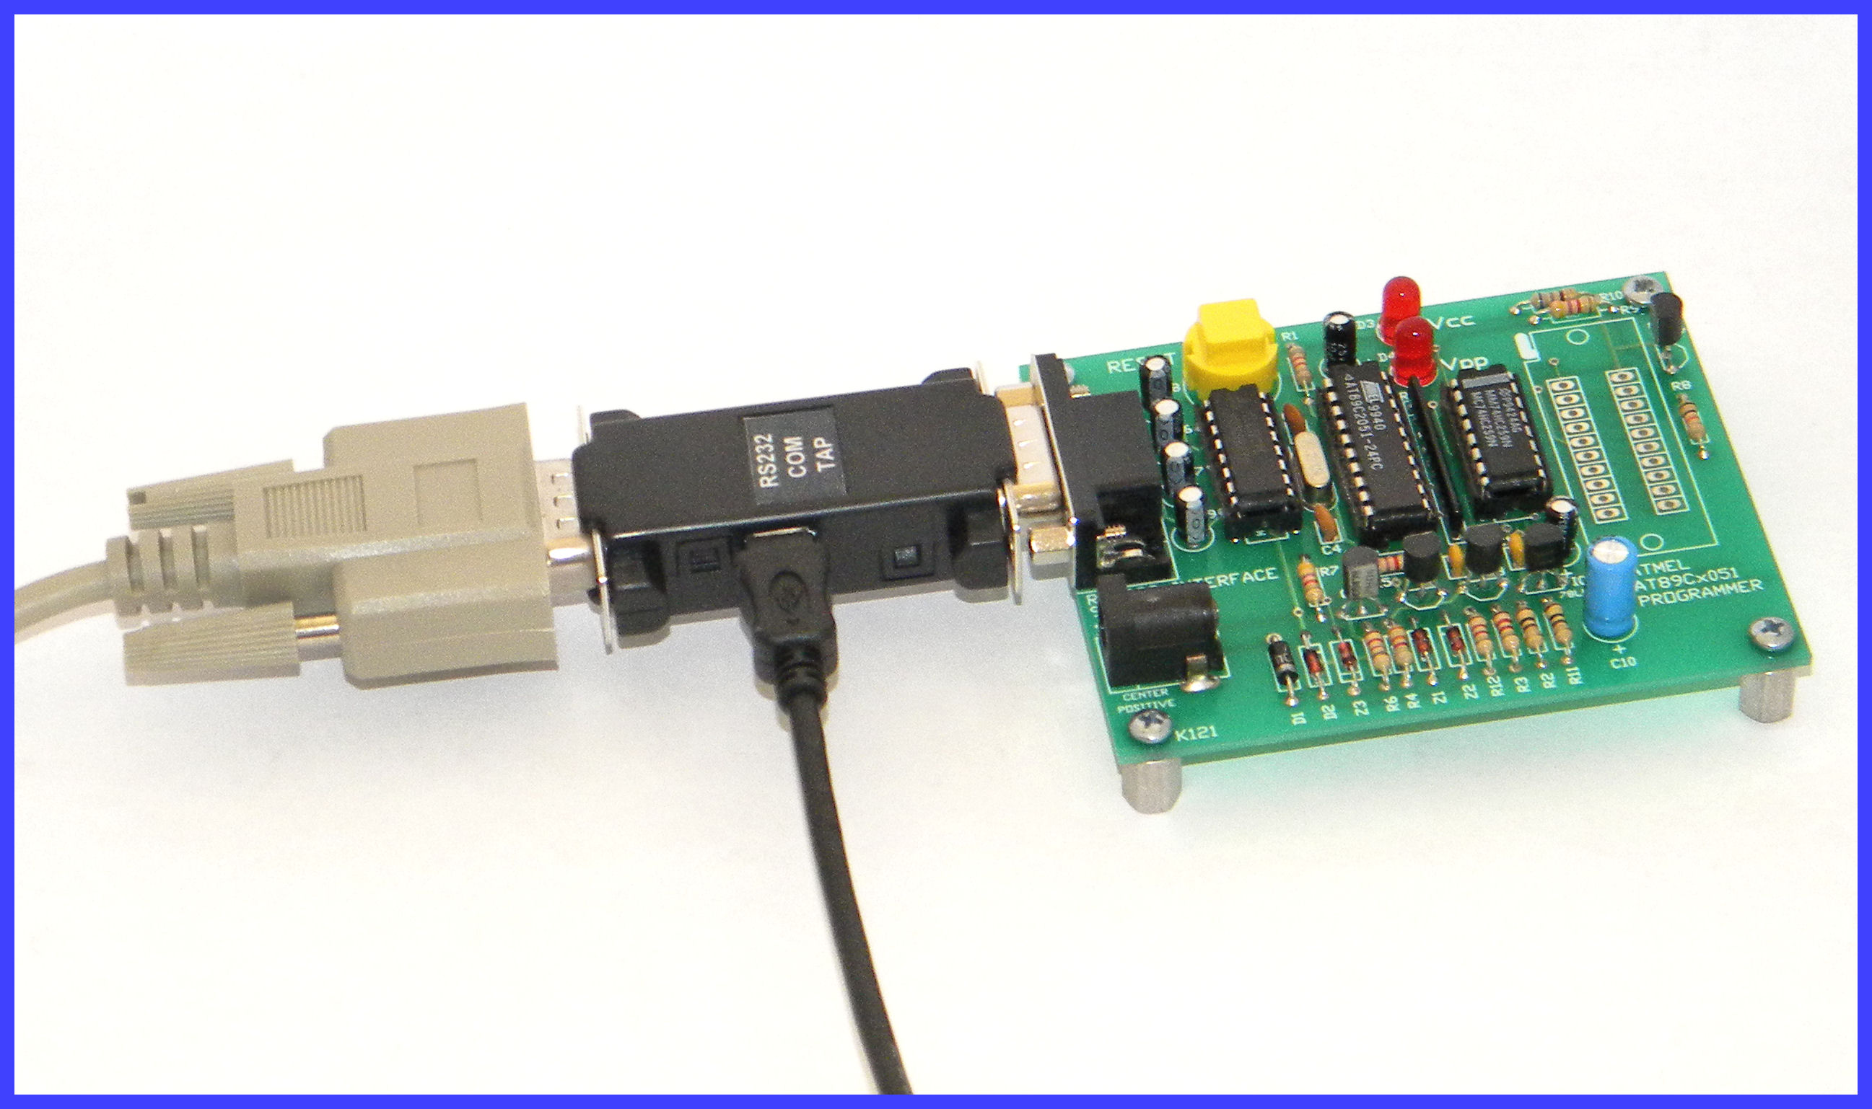

Slide 32
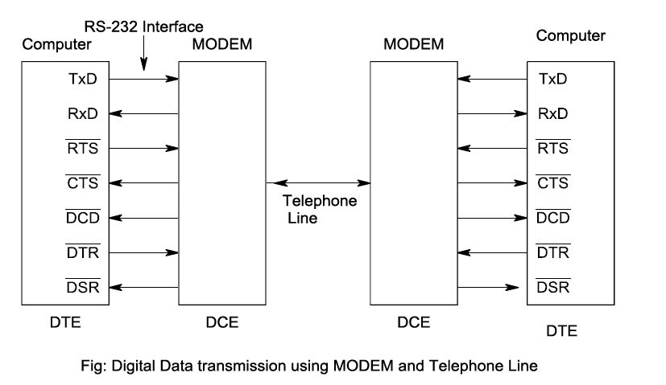

Slide 33
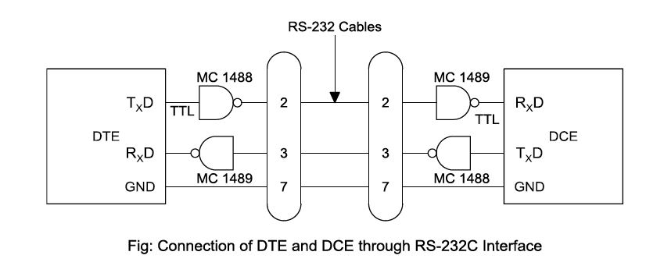

Slide 34
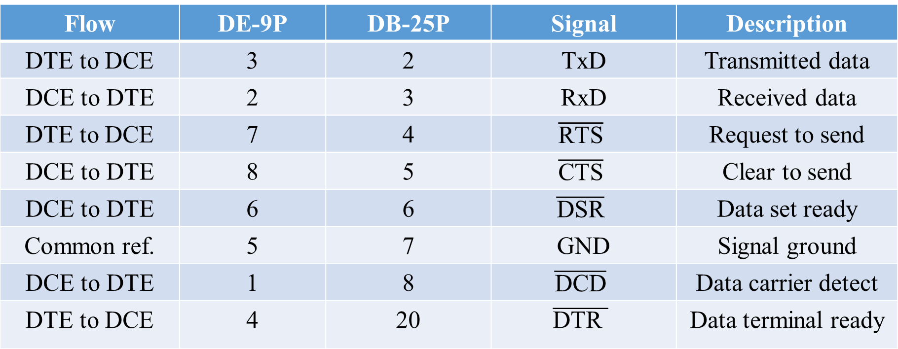
Flow | DE-9P | DB-25P | Signal | Description
DTE to DCE | 3 | 2 | TxD | Transmitted data
DCE to DTE | 2 | 3 | RxD | Received data
DTE to DCE | 7 | 4 | $$\overline{\text{RTS}}$$ | Request to send
DCE to DTE | 8 | 5 | $$\overline{\text{CTS}}$$ | Clear to send
DCE to DTE | 6 | 6 | $$\overline{\text{DSR}}$$ | Data set ready
Common ref. | 5 | 7 | GND | Signal ground
DCE to DTE | 1 | 8 | $$\overline{\text{DCD}}$$ | Data carrier detect
DTE to DCE | 4 | 20 | $$\overline{\text{DTR} }$$ | Data terminal ready

Slide 35
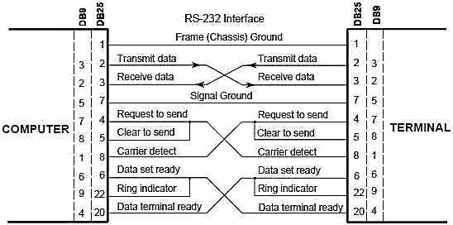

Slide 36
Simplex and Duplex Transmission • Simplex. – One-way transmission. – Only one wire is needed to connect the two devices – Like communication from computer to a printer.
• Half-Duplex. – Two-way transmission but one way at a time. – One wire is sufficient.
• Full-Duplex. – Data flows both ways at the same time. – Two wires are needed. – Like transmission between two computers.

Slide 37
Keyboard & Display Controller:8279
The intel 8279 is specially developed for interfacing keyboard and display devices to 8085/8086/8088 microprocessors based system.

Slide 38
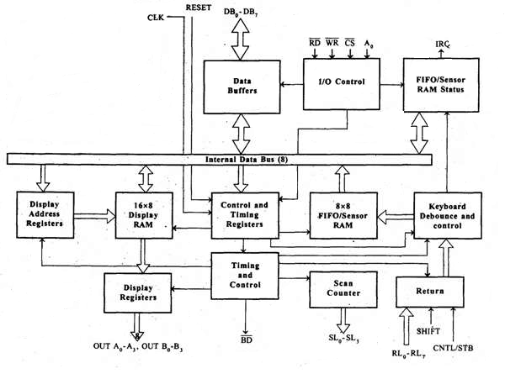
Block Diagram

Slide 39
It consists 4 main section.
CPU interface and control section.
Scan section
Keyboard Section
Display section.
CPU INTERFACE AND CONTROL SECTION:
It consists of
Data buffers
I/O control
Control and timing registers.
Timing and control logic.

Slide 40
Thank You!!!

